Slide 1
Networking
CITS5503 Dr David Glance

Slide 2
Agenda
Networking fundamentals
Network isolation through Network Address Translation
Network Load Balancing

Slide 3
Networking
Creating cloud resources requires some knowledge of networks
Major focus is on TCP/IP (UDP not so much) as this is the basis for HTTP(S)/TLS
Focus on IPv4 addressing rather than IPv6 as the latter still not significantly supported (in Australia)
Need a basic understanding of concepts like:
Routing
Private and public networks
Network latency and throughput

Slide 4
TCP/IP Addressing
IPv4 (where IP is used it implies IPv4) address is made up of 4 bytes and represented as:
nnn.nnn.nnn.nnn
130.95.172.57 (www.csse.uwa.edu.au)
Translation between name and IP address done by Domain Name System (DNS)
Specific ranges of IP addresses reserved as Private Addresses:
RFC1918 name | IP address range | Number of addresses | Largest CIDR block (subnet mask)
24-bit block | 10.0.0.0 – 10.255.255.255 | 16,777,216 | 10.0.0.0/8 (255.0.0.0)
20-bit block | 172.16.0.0 – 172.31.255.255 | 1,048,576 | 172.16.0.0/12 (255.240.0.0)
16-bit block | 192.168.0.0 – 192.168.255.255 | 65,536 | 192.168.0.0/16 (255.255.0.0)
Carrier-Grade NAT | 100.64.0.0 – 100.127.255.255 | 4,194,304 | 100.64.0.0/10 (255.192.0.0)

Slide 5
Networks and Hosts
To route a TCP/IP packet on the Internet, need to know its destination
Determined by its network address and host address on that network
Configuration of network interface is done with an IP address and Subnet mask
130.95.172.57 with Mask 255.255.255.0
Network address is 130.95.172.57 AND 255.255.255.0 → 130.95.172.0
Host address is 130.95.172.57 AND complement of 255.255.255.0
130.95.172.57 AND 0.0.0.255 → 0.0.0.57
Network addressing is done using Classless Inter-Domain Routing (CIDR)
Special addresses: First address is network address (e.g. 130.95.172.0), Last address is broadcast (all hosts) address (130.95.172.255)

Slide 6
CIDR Examples
CIDR allows us to subnet IP addresses for:
performance
administration e.g. An organisation is given a subnet:
130.95.141.192 Netmask: 255.255.255.192
192 is 1100 0000
This works out as 130.95.141.192/26 = 64 hosts

Slide 7
CIDR Examples
A: 172.16.17.30/20
B: 172.16.28.15/20
Are they on the same subnet? Need to work out the fist and last address of that subnet and then see if B is in it.
First address is done using a bitwise AND on the address and subnet mask
172.16.17.30 - 10101100.00010000.00010001.00011110
255.255.240.0 - 11111111.11111111.11110000.00000000
-----------------|AND|-------------
subnet = 10101100.00010000.00010000.00000000 = 172.16.16.0
Last address is done using a bitwise OR on the address and the complement of the mask
172.16.17.30 - 10101100.00010000.00010001.00011110
255.255.240.0 - 00000000.00000000.00001111.11111111
-----------------|OR|--------------
subnet = 10101100.00010000.00011111.11111111 = 172.16.32.255

Slide 8
Classless Inter-Domain Routing (CIDR)
Addresses | bits | prefix | class | Subnet Mask
1 | 0 | /32 | - | 255.255.255.255
2 | 1 | /31 | - | 255.255.255.254
4 | 2 | /30 | - | 255.255.255.252
8 | 3 | /29 | - | 255.255.255.248
16 | 4 | /28 | - | 255.255.255.240
.. | .. | .. | .. | ..
512 | 9 | /23 | 2C | 255.255.254.0
1K | 10 | /22 | 4C | 255.255.252.0
.. | .. | .. | .. | ..
64K | 16 | /16 | 1B | 255.255.0.0
128K | 17 | /15 | 2B | 255.254.0.0
256K | 18 | /14 | 4B | 255.252.0.0
512K | 19 | /13 | 8B | 255.248.0.0
1M | 20 | /12 | 16B | 255.240.0.0
2M | 21 | /11 | 32B | 255.224.0.0
4M | 22 | /10 | 64B | 255.192.0.0
.. | .. | .. | .. | ..
128M | 27 | /5 | 8A | 248.0.0.0
256M | 28 | /4 | 16A | 240.0.0.0
512M | 29 | /3 | 32A | 224.0.0.0
1024M | 30 | /2 | 64A | 192.0.0.0
Notes:
With the advent of CIDR, the classful restrictions no longer exist. Address space may be allocated and assigned on bit boundaries, and routers may use one aggregated route (like 194.145.96.0/20) instead of advertising 16 class C addresses [RFC-1518].
'addrs' represents the number of addresses available; note that the number of addressable hosts normally is 2 less than this number because the host parts with all equal bits (all 0s and all 1s) are reserved. 'bits' represents the size of the allocation/assignment in bits of address space.
'prefix' represents the length of the route prefix covering this address space. This is sometimes used to indicate the size of an allocation/assignment. 'class' represents the size of the address space in terms of classful network numbers. 'mask' represents the network mask defining the routing prefix in dotted decimal notation.

Slide 9

Routing in IPv4
A router has two addresses
An address through which the device inside of the router can be accessed.
Another address belongs to the granted block (subnetwork).
If this network is public it is advertised to route traffic to it
Internet
123.35.0.0/28
Public Subnet
200.4.25.8

Slide 10
IPv4 exhaustion
There are only 4.3 billion IP addresses and they have been officially exhausted
Solutions:
IPv6 which has 3.4*10³⁸ addresses
Network Address Translation
CIDR which allowed smaller chunks of IP addresses to be handed out
IPv6 is progressing but Australia slow to adopt
NAT and carrier-grade NAT more common
NAT also provides other benefits

Slide 11
TCP/UDP Ports
IPv4 or IPv6 addresses will get a network packet to a machine but machine needs to know what application to pass this to
Ports are used for this
TCP and UDP have 65,534 ports each
Ports (0 – 1,023) are system ports
Ports (1,024 – 49,151) are user ports
Ports (49,152 – 65,535) are dynamic and/or private ports
Defined in Service Name and Transport Protocol Port Number Registry (https://www.iana.org/assignments/service-names-port-numbers/service-names-port-numbers.xhtml)

Slide 12
Well known ports
Main ones we are interested in:
ssh TCP/UDP Port 22
http TCP Port 80
https TCP Port 443
Applications use sockets to listen and receive packets and to send them

Slide 13

Network Address Translation

Slide 14
Network Address Translation (NAT)
Benefits
Use of a single public or gateway IP address among many devices in a network
Use of a dynamic IP address for home user for sharing
Private Addresses
Range | Total
10.0.0.0 to 10.255.255.255 | 2²⁴
172.16.0.0 to 172.31.255.255 | 2²⁰
192.168.0.0 to 192.168.255.255 | 2¹⁶

Slide 15
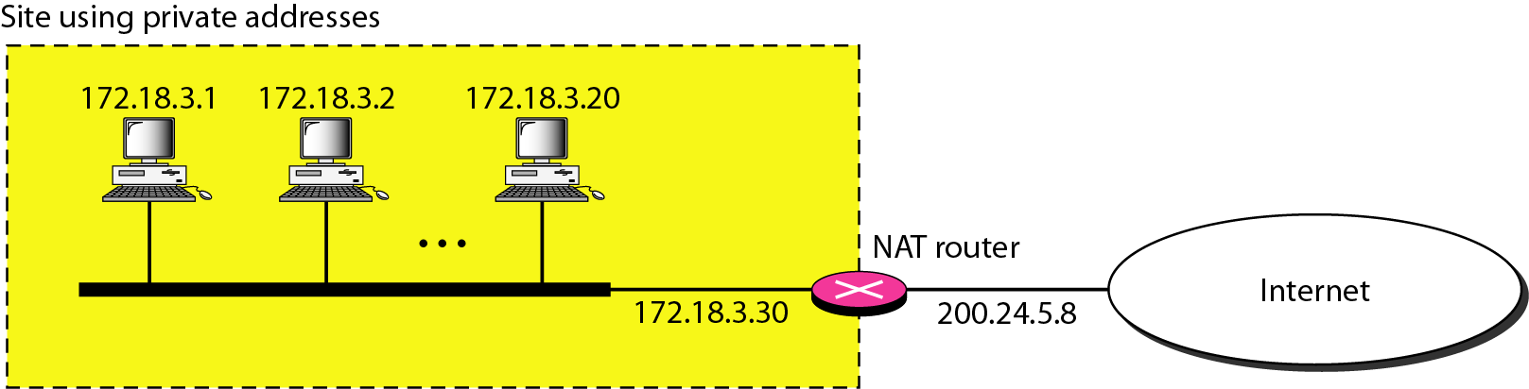
NAT Configuration

Slide 16
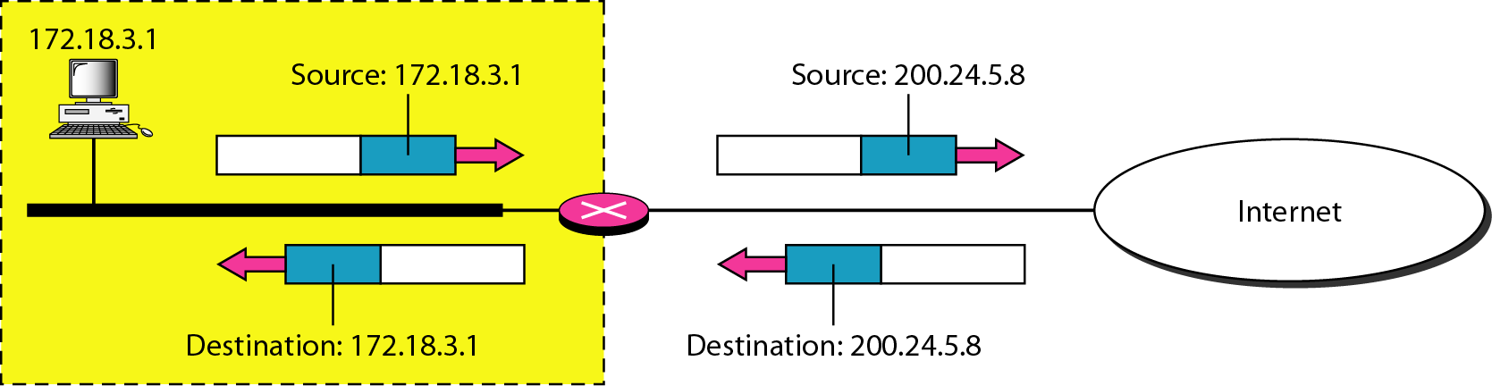
Address Translation

Slide 17
Port mapping
NAT works by keeping a table of private sender IP addresses and ports that map to a port and IP address on its public interface
When the reply comes back from the external IP address, it looks up the table and knows where to send it to
For inbound traffic, external ports need to be explicitly mapped to an ip address and port on the private network
They don’t have to be the same port – so 80 externally can map to 8080 internally

Slide 18
AWS Network
EC2 need to be launched into a Virtual Private Cloud (VPC)
Default VPC defines:
An address space (IPv4 and IPv6): 172.31.0.0/16 (65,536 addresses)
Subnet in each availability zone: e.g. 172.31.0.0/20 and 172.31.16.0/20
Internet Gateway
Main Route Table
Default Security Group
Default Network Access Control List (ACL)
Default DHCP settings

Slide 19
AWS Default VPC

Slide 20
Subnet
Attributes:
Name
VPC associated
Availability Zone
IPv4 CIDR block
IPv6 CIDR block (optional)

Slide 21
Security
Security Groups can be associated with a VPC but they act at the instance level.
If a security group is not specified for an instance, it takes the one assigned to the VPC
ACLs act on a subnet and have different characteristics than a security group

Slide 22
Security
Security Group | Network ACL
Operates at the instance level (first layer of defense) | Operates at the subnet level (second layer of defense)
Supports allow rules only | Supports allow rules and deny rules
Is stateful: Return traffic is automatically allowed, regardless of any rules | Is stateless: Return traffic must be explicitly allowed by rules
We evaluate all rules before deciding whether to allow traffic | We process rules in number order when deciding whether to allow traffic
Applies to an instance only if someone specifies the security group when launching the instance, or associates the security group with the instance later on | Automatically applies to all instances in the subnets it's associated with (backup layer of defense, so you don't have to rely on someone specifying the security group)

Slide 23
Security

Slide 24
Setting up a NAT Gateway
Used to create a private network
Remember that there are multiple ways to isolate instances
Through security groups and ACLs
Putting instances behind a load balancer
NAT Gateway needs to be part of a public network
Private subnet has a custom route table that points all default traffic to the NAT Gateway
NAT Gateways can not be configured to map ports for inbound traffic (unlike home NAT routers)

Slide 25
Configuring a NAT Gateway

Slide 26
Load Balancing

Slide 27
Load Balancing
Load balancers do exactly what they say on the box – load balance
Requests are received and then distributed according to a configurable algorithm (Rule) to a destination IP address (an instance of a Target Group)
Each Rule specifies a Target Group, Condition and Priority
Application load balancers load balance applications at Level 7 of the OSI model.
Network load balancers load balance TCP connections at Layer 4
Load balancing rules can be based on URLs and host headers
Requests can be sent to multiple applications on a host

Slide 28
ELB Advantages
Allows horizontal scale. Greater demand, add more instances
Allows for update of code on machines without interrupting service
Handles termination of SSL for simplified processing on machines
Adds a layer of security as ports on host machines don’t have to be open to the Internet
Can handle different communication protocols

Slide 29
Application Load Balancer

Slide 30
Load balancer at work
1
HTTP Request
GET /index.html
2
1
2

Slide 31
ELB
1
EC2
ELB
An instance can be “drained” of connections and taken offline
EC2
2
3
EC2
EC2
ELB
ELB
EC2
EC2

Slide 32

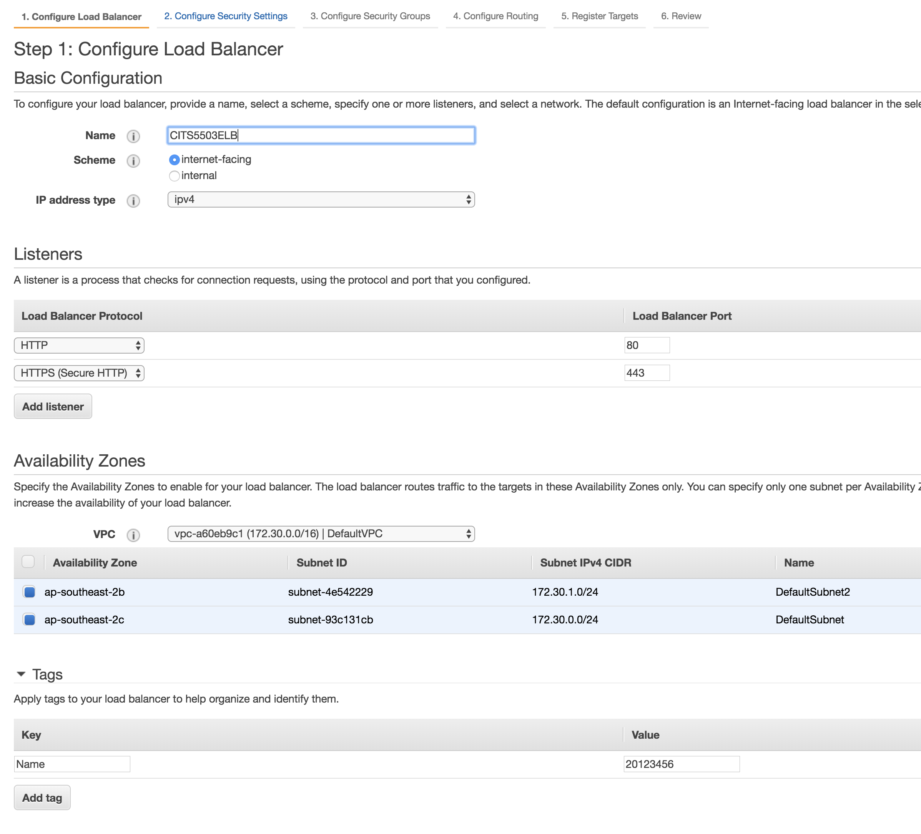
Setting up an Application Load Balancer

Slide 33
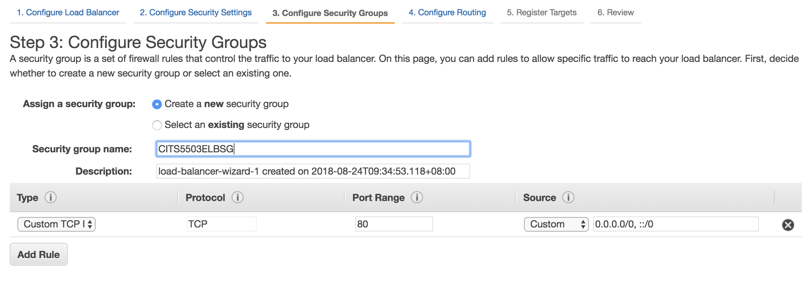
Configure Security Group

Slide 34
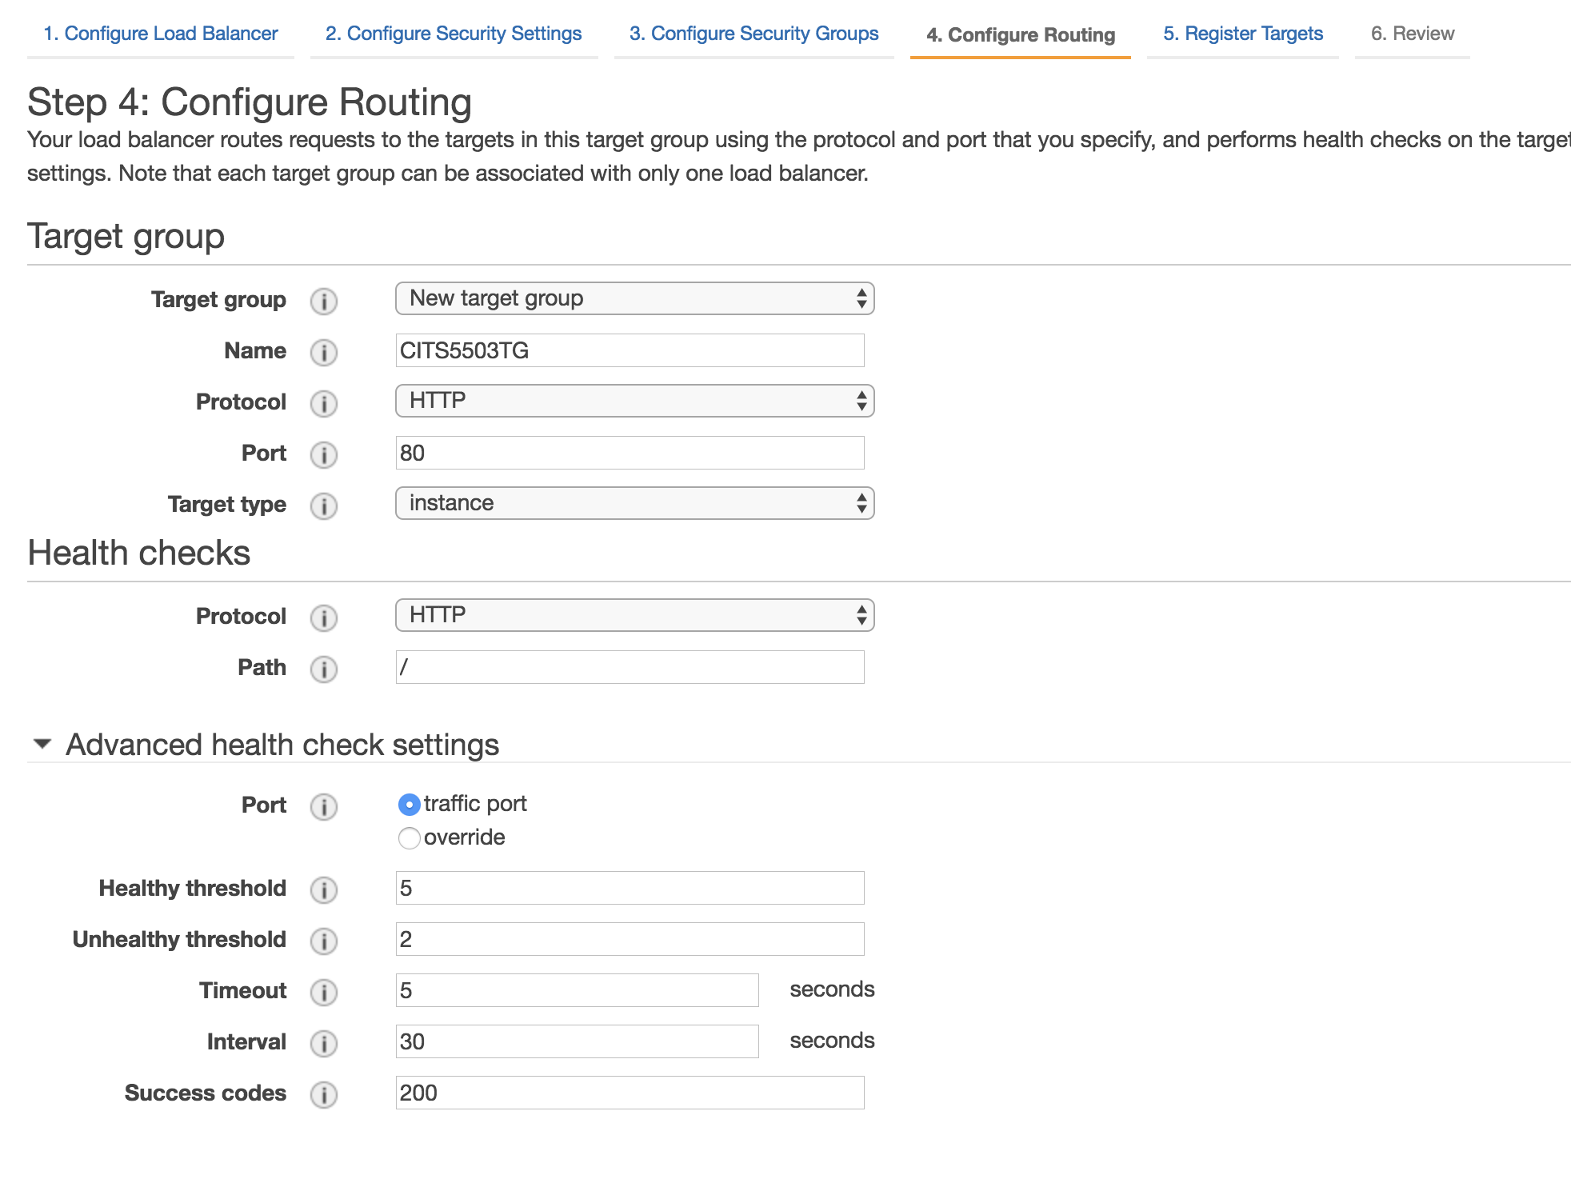
Routing

Slide 35
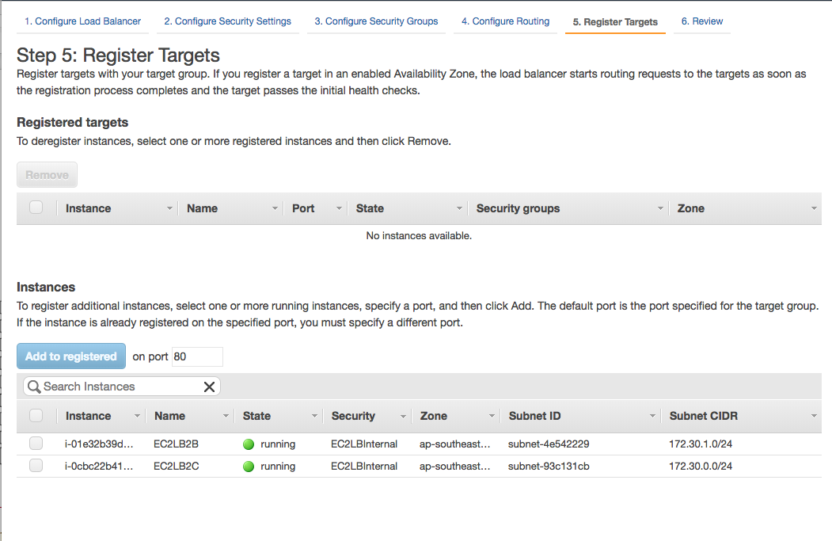
Add instances

Slide 36
How it works
Request coming in to LB is assigned to a connected instance based on an algorithm:
Chooses based on the rules set
Only routes if instance is healthy
Sticky sessions: requests will always go to the instance that handled the fist request from a client (cookie based)
Round robin for TCP load balancer
Least number of requests for Application Load Balancer

Slide 37
Load balancers for maintenance
Using a load balancer, can seamlessly take instances offline and update them, then bring them back on line
Can use to scale by adding more instances
Can load balance over regions
Protects the machines from public exposure
Offload SSL

